Slide 1
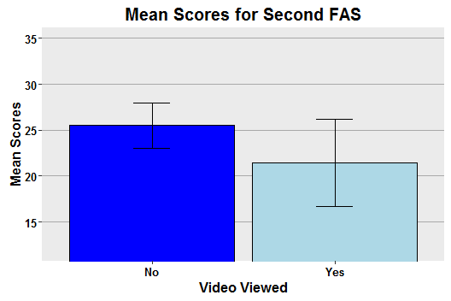
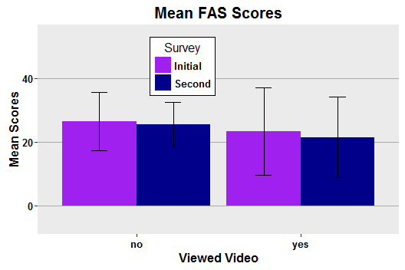
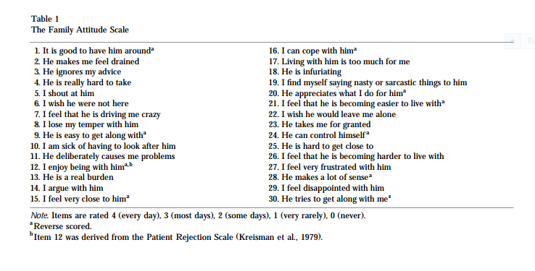
Reduction of Family Members’ Expressed Emotion Through Therapy
Jana L. Chase and Dafne N. Smith Eastern Oregon University
Abstract
Procedure/Design
Discussion
Expressed emotion (EE) of family members negatively influence the treatment outcome of patients with mental disorders (Gar & Hudson, 2009; Garcia-Lopez et al., 2009; Linszen et al., 1997; and Uerhara et al., 2001). Expressed emotion is the hostility, critical statements, and emotional overinvolvement relatives direct toward a family member with a disorder. Gar and Hudson (2009) and Uerhara et al. (2001) showed that therapy/psychoeducation lowered family members’ EE levels. To determine if a parenting video would have a similar effect in reducing EE in family members, especially those with a high level of EE we had 15 participants self-administer the Family Attitude Scale on two separate occasions with seven days between. They were divided into two groups: Video (n= 7) and No Video (n = 8). Participants in the Video group viewed the parenting video “Positive Parenting: 5 Strategies for Being a Patient Parent”. The results were nonsignificant and therefore did not support our hypothesis.
All participants who were currently caring for children under the age of 18 in their home completed the initial FAS. Participants were divided into two groups based upon their year of birth (odd or even year). The odd year group viewed a parenting video. Five days after completing the initial FAS each participant was sent an e-mail reminder to complete the second FAS within the next 48 hours. A person was considered to have a high level of expressed emotions if the score was 50 or higher (Kavanagh et al., 1997)
The results of the study were nonsignificant and did not support our hypothesis.
The weak results of the study may be due to the design and materials used in the study:
Initial rates of EE were not high (i.e. 50+ score on the FAS) at the beginning of the experiment. Previous studies had initial rates high of EE in family member participants. The current study did not have significantly high results, so the lowering rates of EE would not be seen as a significant difference.
The ages of the children living at home consisted of younger children (0-5 years) as a majority. The studies that had been conducted previously mostly consisted of adolescents and young adults as the patients whose family member's rates of EE impacted.
The video may not have been informative enough to make an impact. The single viewing of the parenting video may not have had a significant impact on the parents to substantially decrease their EE. During previous studies, the researchers used several sessions of various family therapy consecutively. We predict that additional videos viewed over an extensive period of time would show decreased rates of EE and provide significant results.
Time between the first part of the experiment and the second part was short in duration. Prior studies collected data while providing therapy over an extensive period of time.
Our study may not have had the significant results as seen in the previous research, however with alterations and improvements to our study significant results might be obtained. Future research is encouraged in furthering support of lowering EE in family members.
Results
Introduction
Previous studies conducted to lower rates of Expressed Emotion (EE) in family members to increase the probability of successful outcomes with patients who suffer with mental disorders led us to research other methods that could potentially lower EE. Expressed emotion is the negative emotions and attitudes, such as hostility, critical statements, and emotional overinvolvement that relatives direct toward a family member with a disorder.
Linszen et al. (1997) demonstrated that high EE to be the most significant risk factor for the relapse of patients with disorders such as schizophrenia and other psychological disorders.
Garcia-Lopez, Muela, Espinosa-Fernandez, and Diaz-Castela (2009) found that adolescents with social anxiety disorder whose parents were low in EE had a significant reduction in their anxiety scores after treatment and were able to maintain those reduced scores at the 6-month follow-up
Gar and Hudson (2009) showed that family-based cognitive behavior therapy designed for the parent can reduce high EE.
Uerhara, Kawashima, Goto, Tasaki, and Someya (2001) established that psychoeducation does lower EE in families of patients with eating disorders and suggested further studies should include a control group to strengthen the claims made about psychoeducation in reducing the rates of EE in family members.
Figure 1. The mean scores for the second FAS. Error bars reflect standard error of the means.
Our study measured the effectiveness of a parenting video in the reduction of expressed emotion. The Family Attitude Scale (FAS) was used to determine participants’ baseline levels of EE and for comparison seven days after the first FAS.
Our hypothesis was not confirmed: There was no significant differences in the scores of the second survey between subjects who viewed the parenting video (M = 21.43) and those who did not view the video (M = 25); F(1,13) = .624, p = .444.
References
Method
Gar, N. S., & Hudson, J. L. (2009). Changes in maternal expressed emotion toward clinically anxious children following cognitive behavioral therapy. Journal of Experimental Child Psychology, 104, 346-352. doi:10.1016/j.jecp.2009.06.001
Garcia-Lopez, L., Muela, J. M., Espinosa-Fernandez, L., & Diaz-Castela, M. (2009). Exploring the relevance of expressed emotion to the treatment of social anxiety disorder in adolescence. Journal of Adolescence, 32, 1371-1376. doi:10.1016/j.adolescence.2009.08.001
Linszen, D. H., Dingemans, P. M., Nugter, M. A., Van der Does, A. J. W., Scholte, W. F., & Lenior, M. A. (1997). Patient attributes and expressed emotion as risk factors for psychotic relapse. Schizophrenia Bulletin, 23, 119-130. doi:10.1093/schbul/23.1.119
Uehara, T., Kawashima, Y., Goto, M., Tasaki, S., & Someya, T. (2001). Psychoeducation for the families of patients with eating disorders and changes in expressed emotion: A preliminary study. Comprehensive Psychiatry, 42, 132-138. doi:10.1053/comp.2001.21215
Kavanagh, D.J., O’Halloran, P., Manicavasagar, V., Clark, D., Piatkowska, O., Tennant, C., & Rosen, A. (1997). The family attitude scale: Reliability and validity of a new scale for measuring the emotional climate of families. Psychiatry Research, 70, 185-195. doi:10.1016/S0165-1781(97)00033-4
Participants
The study initially had 62 participants. Due to ineligibility or incompletion the study concluded with 15 participants. Participants included 15 parents who had children under the age of 18 living at home and completed both steps in the research. The largest age group of children was 0-5 years (n = 10).
Materials
Survey monkey was used to obtain data. Permission from Samantha Moe was given to use the video, "Positive Parenting: 5 strategies to becoming a better parent." The Family Attitude Scale (FAS) was used to measure rates of EE through permission of Elsevier.
Figure 2. The mean scores for the initial and second FAS for participants who viewed or did not view the parenting video. Error bars reflect standard error of the means.
The results of a two way between subject ANOVA showed there was no main effect of viewing the video upon the FAS scores, F(1) = .9, p = .362. There was no main effect of the time of the survey upon the FAS scores, F(1) = .13, p = .724. There was no interaction of the viewing of the video and time of the survey upon the FAS scores, F(1) = .012, p = .914; (see Figure 2).

